Slide 1
System analysis and practical software realization of making decision in the conditions of uncertainty at cargo transportation on railway transport
Saint- Petersburg State University of Aerospace Instrumentation
Master program “Intellectual transport systems”
Department of “System analysis and logistics”
Author: Mariya Makarenko
e-mail: makarka-m@mail.ru
Russia
Saint-Petersburg
2016

Slide 2
Research objective
Elimination of uncertainty at decision-making in the conditions of existence of a large number of cargo transportation routes and various costs for each of them on railway transport

Slide 3
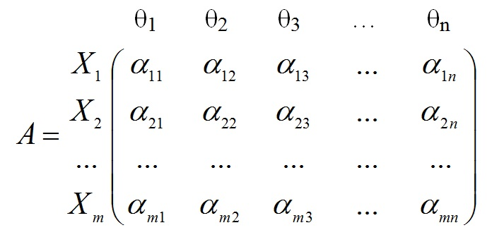
Universal matrix of the income or losses
Transfer all possible situations which aren't depending on person of the making decision
Make the analysis of all possible alternative decisions of cargo transportation
Determine the cost of cargo delivery by this or that route for each carrier
{θ₁, θ₂, ,..., θ_{n}} – all situations which aren't depending on the decision-maker
{X₁, X₂,..., X_{m}} – all alternative decisions
α_{ij} – the expected income (expenses) at decision-making of X_{i} during approach of an event θ_{j}

Slide 4
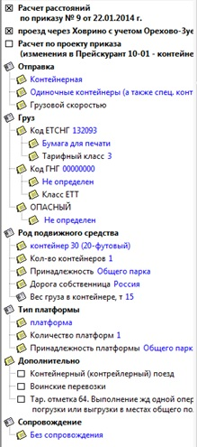
Data for calculation
Information of the transported cargo
Stations of departure and appointment

Slide 5
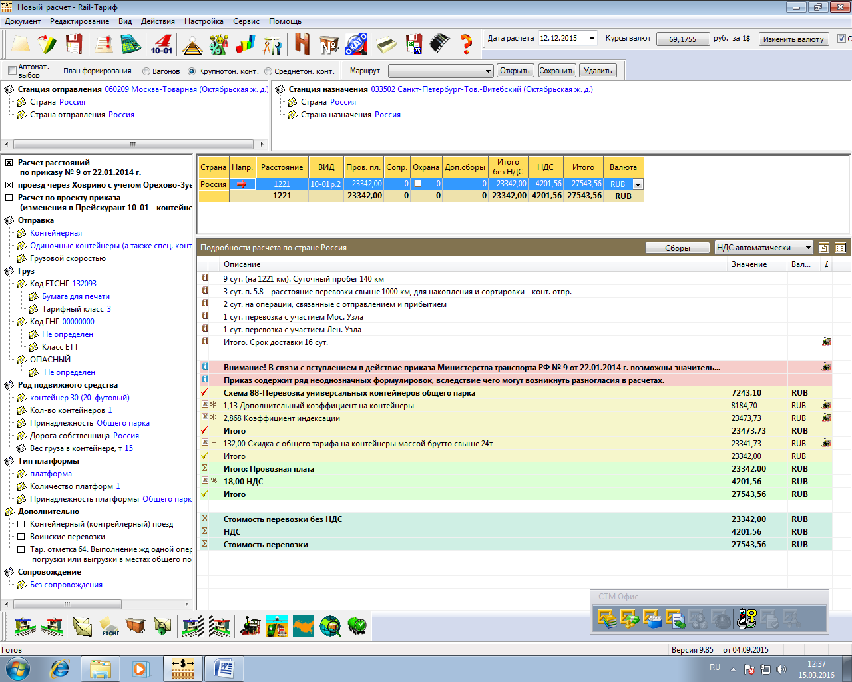
Result of calculation in Rail-Tariff
Tariff cost
27 543,56 RUB

Slide 6
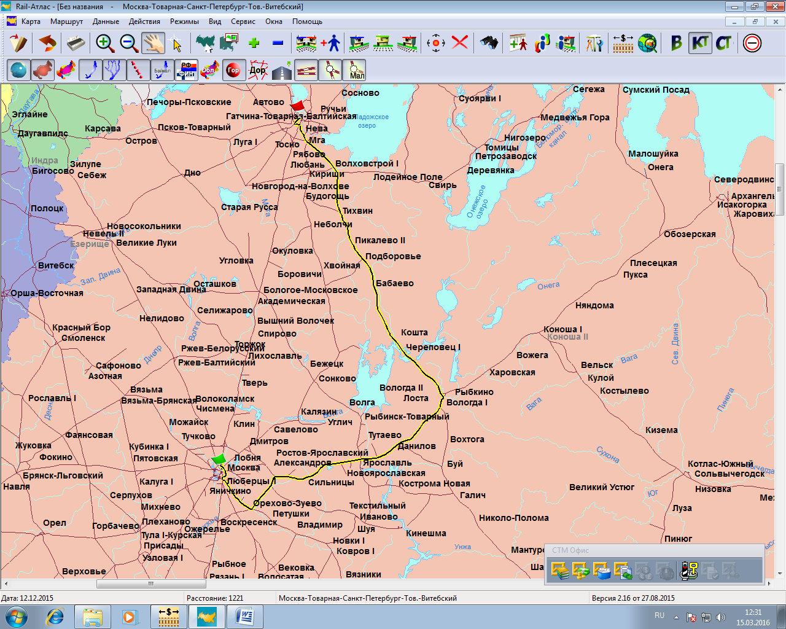
The first constructed rout by the program
Tariff cost
27 543,56 rub
Distance
1221 km

Slide 7
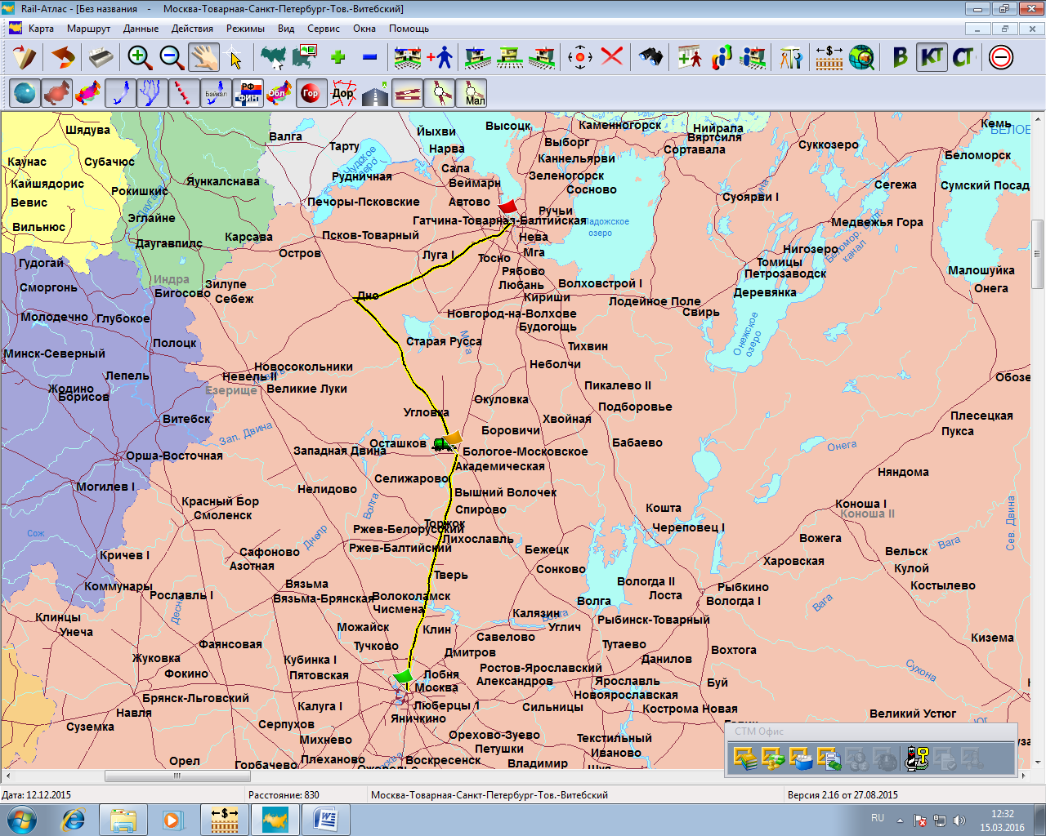
Changed transportation route by decision-maker
Tariff cost
22 344,48 rub
Distance
830 km
way station

Slide 8
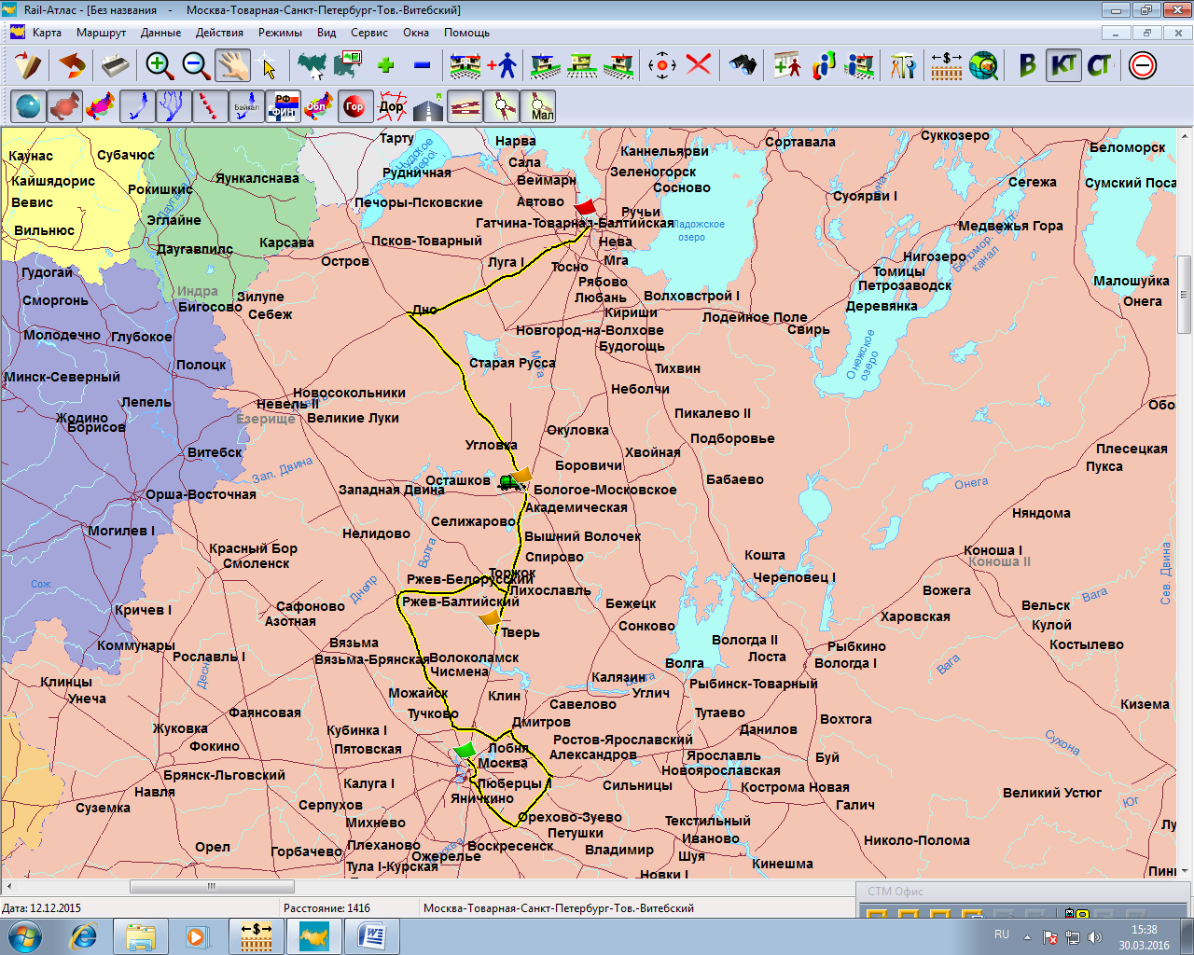
Another variant of route by decision-maker
way station 1
Tariff cost
30 138,38 rub
Distance
1416 km
way station 2

Slide 9
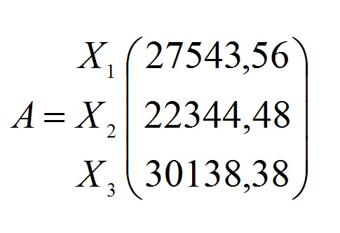
Final form of a matrix
Monadic matrix, dimension 1х3
A – name of matrix
X₁, X₂, X₃ – automatic route, route with 1 way station, with 2 way stations
Numbers – tariff cost of cargo transportation route

Slide 10
Results
Constructed rout for rail transportation
Calculated cost of tariff
Making decision with the help of software «CTM»
Liquidating uncertainty situations

Slide 11
Thanks for your attention!

