Slide 1
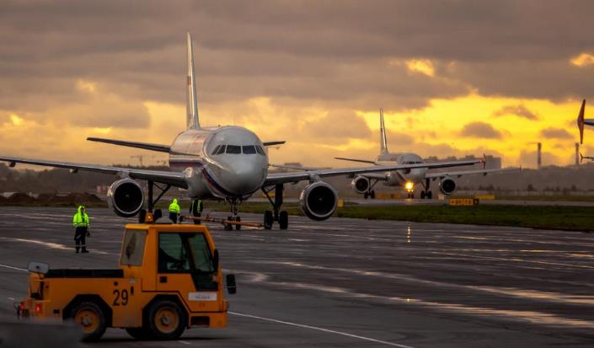
SUBJECT: PRACTICAL RESEARCH OF THE ANALYSIS AND AUTOMATION OF THE WORK OF THE AIRPORT SYSTEMS ON THE BASIS OF MATHEMATICAL MODELS AND SIMULATION MODELING
Saint- Petersburg State University of Aerospace Instrumentation
Authors: VERSHININA M.M.
OKHREMENKO A.A
Masters degree “System analysis and control”

Slide 2
MATHEMATICAL METHODS OF MODELING PASSENGER TRANSPORTATION
The urgency of the work is the introduction into the baggage system of the airport and the processing of the aircraft. Dynamic simulation objects are used in the work. The dynamics of the simulated system is represented as a sequence of operations.
The simulation model was built on the basis of a technological schedule for servicing the aircraft, in accordance with which the operational planning and management preparation processes of aircraft for flight is being carried out.
The structural model (reliability) is represented in the form of logical relationships, the conditions under which the system and the object are in a workable state.
Elements :
The queue of events;
Events;
Event handlers;
Medel time;
Condition;
Statistics.

Slide 3
GOAL OF THE WORK
To describe the mathematical model for calculating the reliability of the luggage system of the airport.
To describe the construction of a simulation model for the technological processes at parking sites of servicing aircraft.
Stages of work performance:
Collection of information at the airport
Processing of received data
Constructing the logic
Creating a simulation model

Slide 4
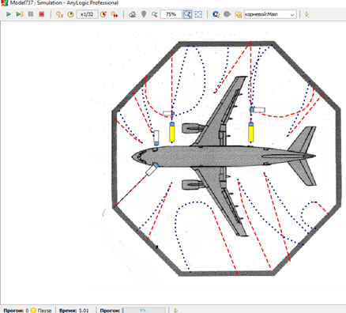
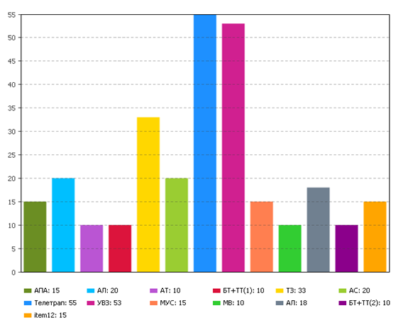
TECHNOLOGICAL PROCESSES OF GROUND HANDLING
Results of simulation
Time chart of
aircraft maintenance
This approach allows to organize the realization of operations of the maintenance of flights, and monitor the implementation of these operations. This is achieved by splitting one process into elementary components - technological operations.
The advantage of the model is that it allows to analyze the processing process by adjusting the model parameters, in other words, state of the system while changing the route of movement of each vehicle, duration of one of the operations or entire process, makes possible to predict the behavior of the system.

Slide 5
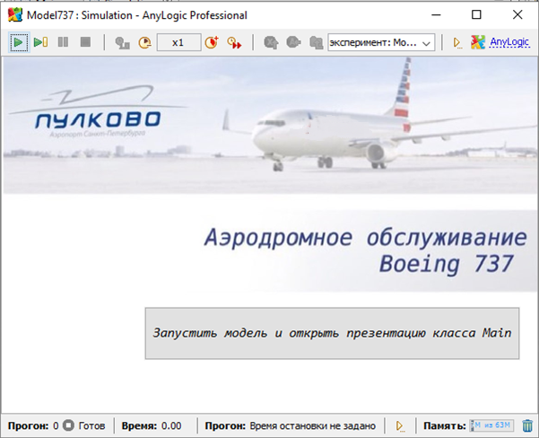
RATIONALITY OF TECHNOLOGICAL PROCESSES OF GROUND AIRCRAFT SERVICE
Simulation was carried out for the fullest range of services provided by airport services for this aircraft, subject to the use of the largest number of special equipment.
The method allows to increase the level of flight safety, operational efficiency, which in general will increase the efficiency of the ground handling system at the airport.
The conducted researches confirm the rationality of using the current technological service schedule.

Slide 6
CONCLUSION
Possible to do based on this model
To train airport staff
To automate decision-making on aircraft maintenance
To beat various options in systems

Slide 7
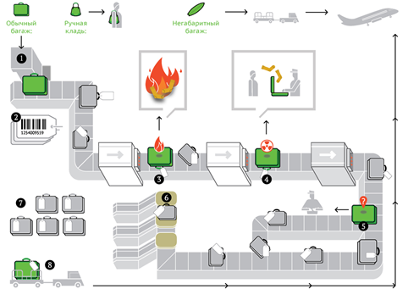
THE AIRPORT BAGGAGE SYSTEM
It is necessary to improve the accuracy and continuity of the luggage system. This is impossible without assessing the reliability of its work
Computation of the reliability of the system is calculated on the basis of the construction of the structural diagram.
The baggage system of the airport is a system with a permanent reservation.
The baggage system of Airport consists of 934 elements.
General scheme of moving baggage through the system

Slide 8
RELIABILITY OF THE AIRPORT BAGGAGE SYSTEM
The probability of failure-free operation according to statistical data on failures:
n(t) is a number of elements of the baggage system that have not failed by the time; N is the number of all baggage elements involved in the process; P (t) is the statistical estimation of the probability of failure-free operation of the service.
The failure rate according to statistical data on failures is determined by the expression:
Δn(t) is the number of failed elements on the time interval (t, t+Δt); F (t) is the statistical estimate of the failure rate of the elements; Δt is the time interval.
Statistical data on the number of failures of elements for 157 days are substitute to developed mathematical model. The final reliability of the system is 0.41. The baggage system existing at the airport has sufficient reliability to ensure efficient work of the airport.

Slide 9
CONCLUSIONS
With proper implementation of standards and service instructions, the system works seamlessly, ensuring the efficient allocation and use of airport resources.
The existing luggage system at the airport has enough reliability to ensure efficient operation of the airport.
The model developed in this work can be used in the future to assess the reliability and efficiency of the existing baggage system in the airport.
On the basis of the program tool given in the work, it is possible to play various possible non-regular situations.
With the help of the software used in the work, it is possible to automate decision making for aircraft maintenance.

Slide 10
THANK YOU FOR ATTENTION!
Authors: VERSHININA M.M.
OKHREMENKO A.A
Saint Petersburg State University of Aerospace Instrumentation (SUAI)

